Slide 1


CSE3006 – NEURAL NETWORK & FUZZY LOGIC
Department of Computer Science Engineering
School of Engineering

Slide 2
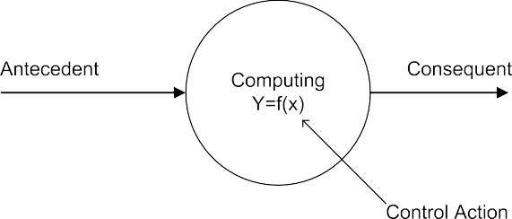
Basics of Computing
y = f (x ), f is a mapping function
f is also called a formal method or an algorithm to solve a problem
Figure 1: Basic of computing

Slide 3
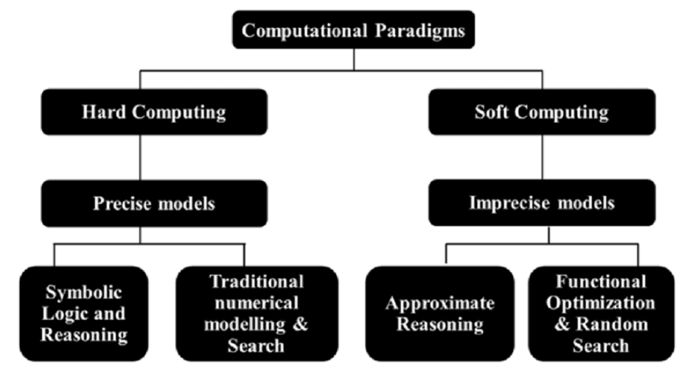
Computational Paradigms

Slide 4
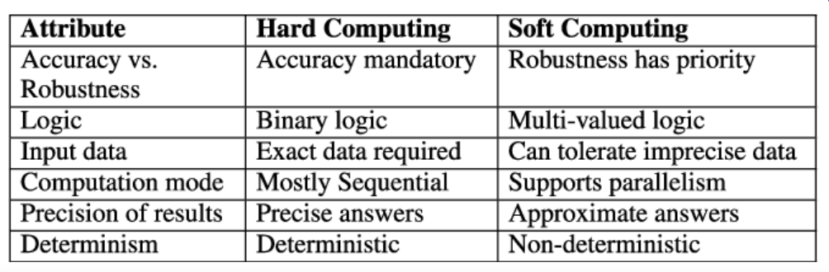
Computational Paradigms

Slide 5
Soft Computing
Deals with the soft meaning of concepts.
According to Prof. Zadeh, soft computing is “an emerging approach to computing, which parallels the remarkable ability of the human mind to reason and learn in an environment of uncertainty and imprecision”.
Soft computing technologies are :
robust by design
operate by trading off precision for tractability
Since they can handle uncertainty with ease, they conform better to real-world situations and provide lower cost solutions.

Slide 6
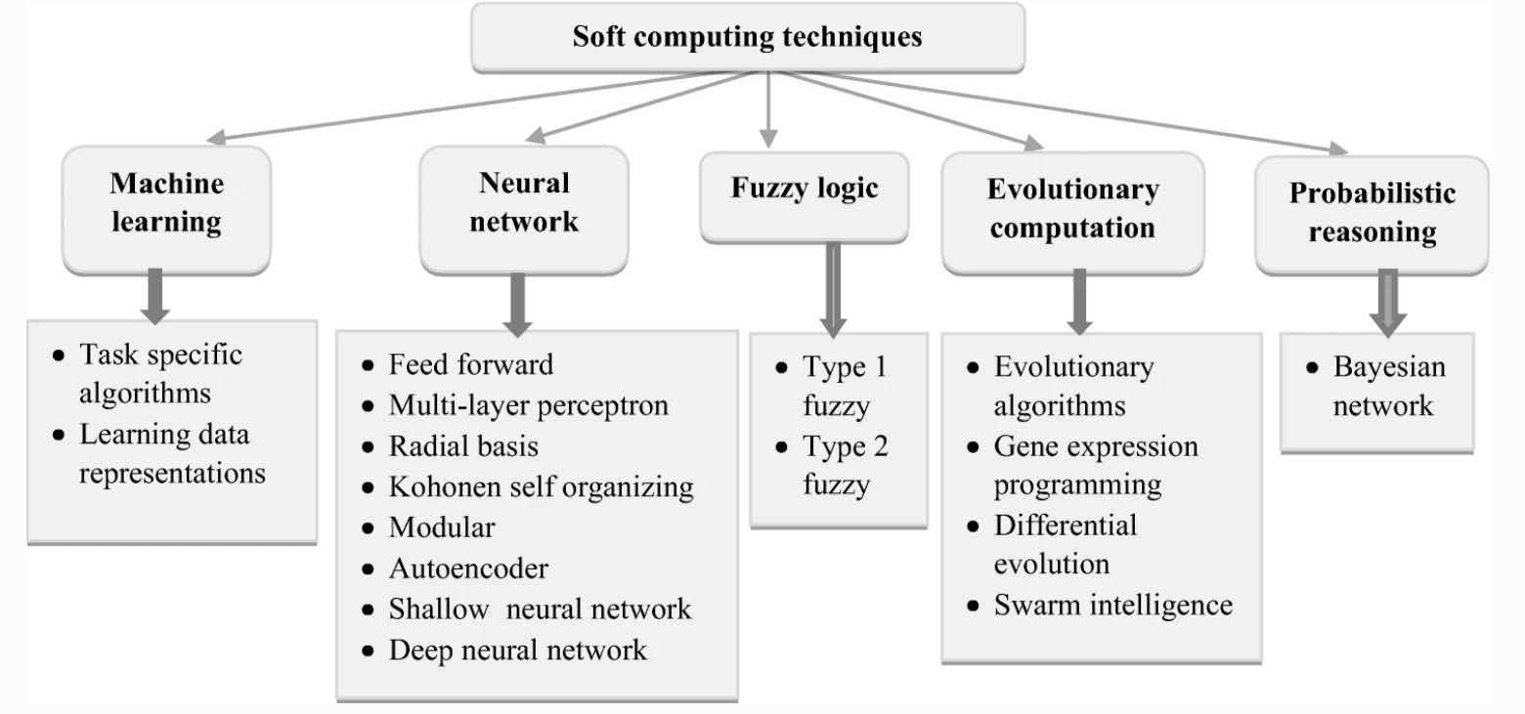
Soft Computing

Slide 7
Neural Networks
The human brain is a highly complex structure viewed as a massive, highly interconnected network of simple processing elements called neurons.
Artificial neural networks (ANNs) or simply we refer it as neural network (NNs), are simplified models (i.e. imitations) of the biological nervous system, and obviously, therefore, have been motivated by the kind of computing performed by the human brain.
The behavior of a biological neural network can be captured by a simple model called artificial neural network.

Slide 8
Neural Networks
A neural network is a massively parallel distributed processor made up of simple processing units that has a natural propensity for storing experiential knowledge and making it available for use. It resembles the brain in two aspects:
Knowledge is acquired by the network from its environment through a learning process.
Interneuron connection strengths, known as synaptic weights, are used to store the acquired knowledge.

Slide 9
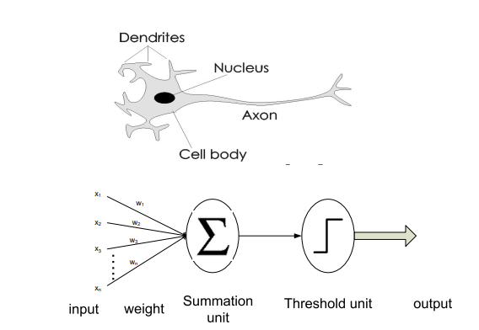
Analogy Between Neuron and an Artificial Neuron

Slide 10
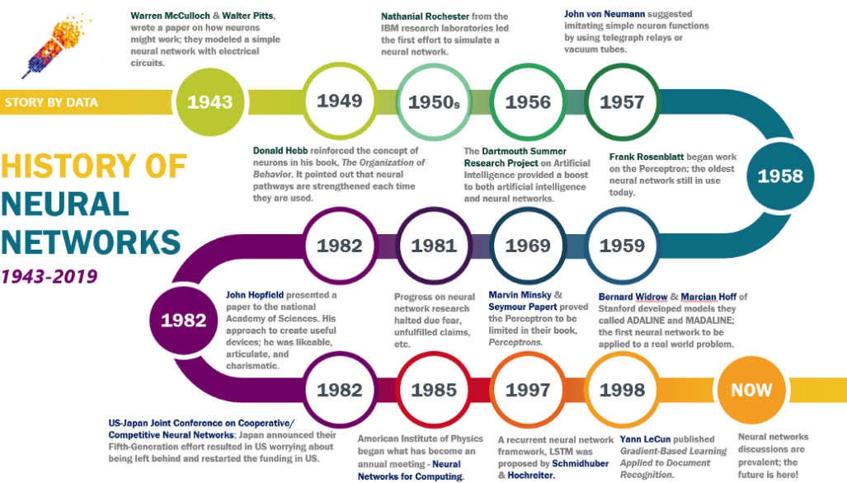
History of Neural Networks

Slide 11
Benefits of Neural Networks
Nonlinearity
Input-Output Mapping
Adaptivity
Evidential Response
Contextual Information
Fault Tolerance
VLSI Implementability
Uniformity of Analysis and Design
Neurobiological Analogy

Slide 12
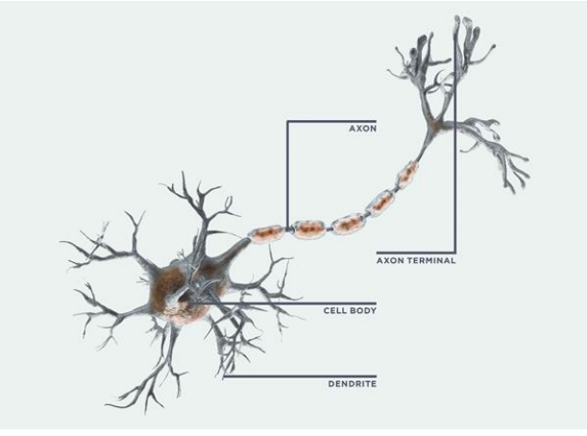
Biological Neurons
Neurons are unique cells in the brain.
They carry information throughout the body.
Each component of the neuron is crucial.
Dendrites, the "hairs" that surround the cell body, transmit data.
The cell body integrates data from several dendrites.
The message is carried by the long, tail-like axon.
From the axon terminals, information "jump" to the next neuron.

Slide 13
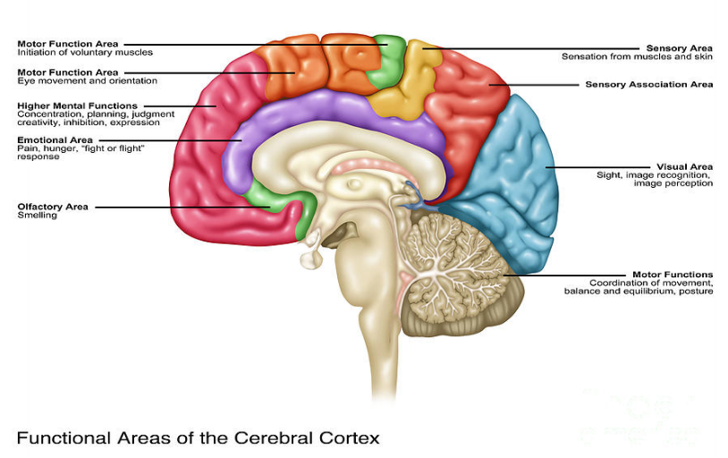
Biological Neurons

Slide 14
Characteristics of Biological Neural Network
Many signals are received by the processing element.
Weight at the receiving synapse can change the signal.
The weighted inputs are added in the processing element.
The neuron transmits a single output when the conditions are right (enough input).
A neuron's output may be distributed to a large number of additional neurons (the axon branches).

Slide 15
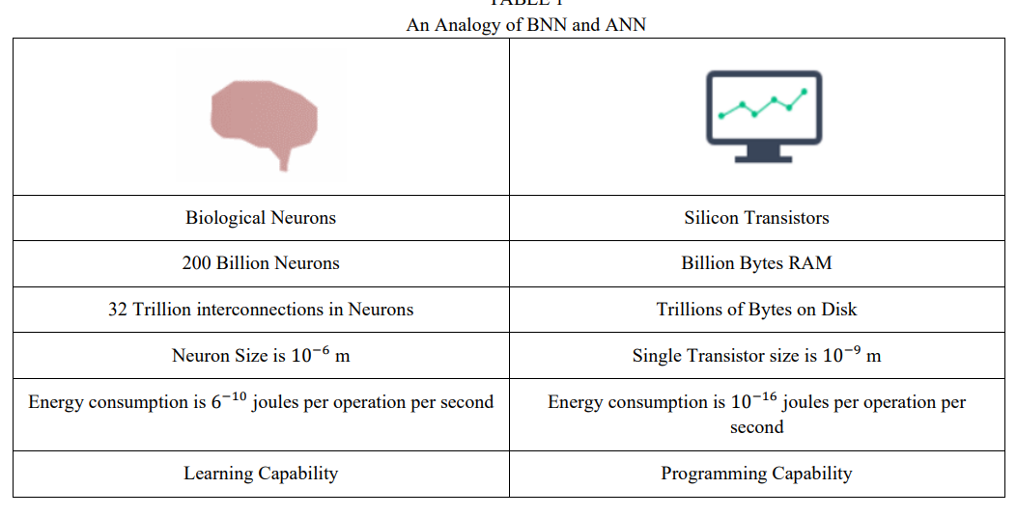
Comparison between Human Brain and Neural Net

Slide 16
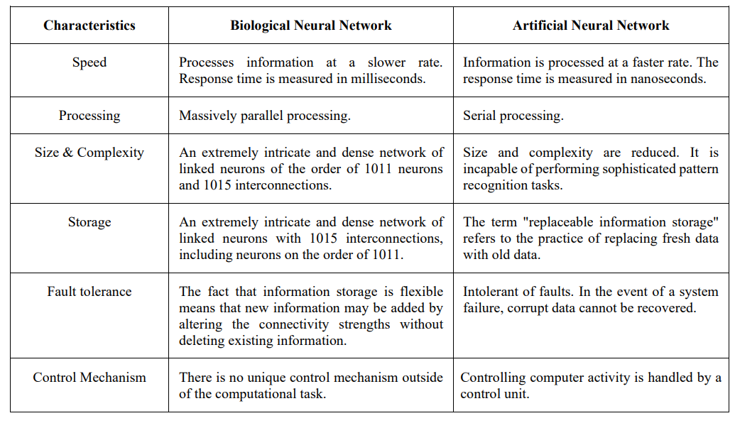
Comparison between Human Brain and Neural Net

Slide 17
Artificial Neural Network
A artificial neural network is an information-processing system.
It has certain characteristics in common with biological neural networks.
Its is a generalization of mathematical models of human cognition or neural biology, based on the following assumptions:
Information processing occurs with simple elements called neurons.
Signals are passed between neurons over connection links.
Each connection link has an associated weight, which in a typical neural net multiplies the signal transmitted.
Each neuron applies an activation function to its net input to determine its output signal.

Slide 18
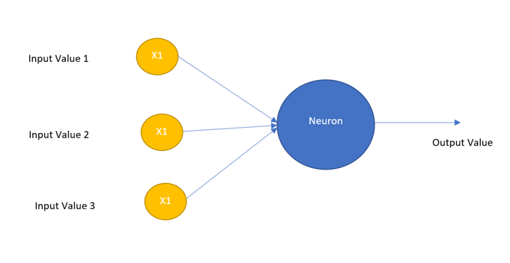
Artificial Neural Network
The Perceptron/ Rosenblatt’s Perceptron in the example contains three inputs, x1, x2, and x3.
It might have more or fewer inputs in general.
To compute the outcome, Rosenblatt developed a simple rule.
He created weights, w1, w2, ..., which are actual values that reflect the significance of the various inputs to the output.
The neuron's output, which is either 0 or 1, is decided by whether the weighted sum ∑jwjxj is less than or larger than some threshold number.
A threshold, like weights, is a real number that serves as a neuronal parameter.

Slide 19
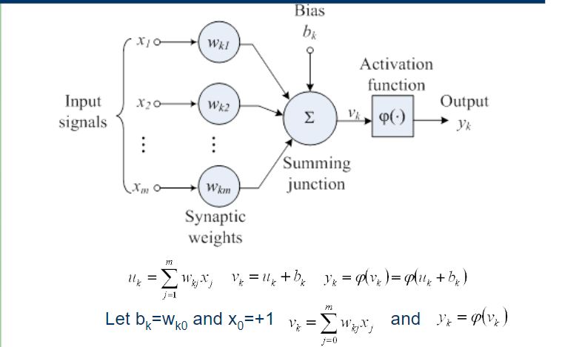
Nonlinear Model of Neuron

Slide 20
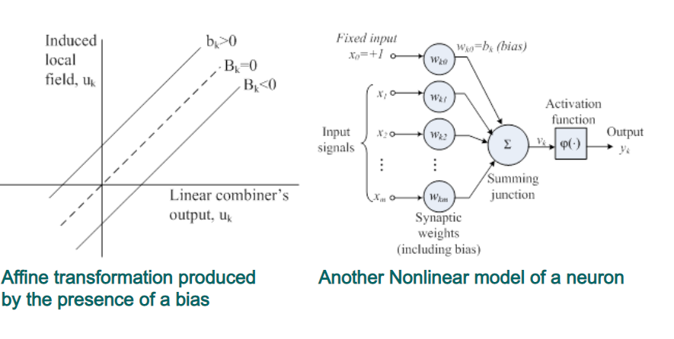
Nonlinear Model of Neuron contd…

Slide 21
Idealized neurons
To model things we have to idealize them (e.g. atoms)
Idealization removes complicated details that are not essential for understanding the main principles.
It allows us to apply mathematics and to make analogies to other, familiar systems.
Once we understand the basic principles, its easy to add complexity to make the model more faithful.

Slide 22
Characteristics of ANN
With characteristics of Neural Networks, the capacity to solve problems in a human-like manner and to apply that ability to large datasets neural networks have the following characteristics –
Adaptive Learning: Neural networks, like humans, represent non-linear and complicated interactions and build on prior knowledge through adaptive learning. Software that teaches arithmetic and language arts, for example, employs adaptive learning.
Fault Tolerance: Neural networks can fill in the gaps when important portions of a network are lost or absent. This skill is particularly valuable in space travel, where electronic gadget failure is a constant risk.
Prognosis: The capacity of neural networks to forecast based on models has several uses, including weather and transportation.
Real-Time Response: As with self-driving vehicles and drone navigation, neural networks may give real-time responses.
Self-Organization: Neural networks are especially suited for organising the complex visual issues posed by medical image analysis due to their capacity to cluster and categorise large volumes of data.

Slide 23
Features of ANN
Features of Neural Network Neural Networks are used to accomplish a variety of tasks –
Associating: Pattern recognition may be taught to neural networks. When you present an unknown version of a pattern, the network correlates it with the most similar version in its memory and switches to that version.
Classification: Neural Networks classify patterns or information into predetermined categories.
Clustering: They categories the data by identifying a unique characteristic without having any prior knowledge of the data.
Prediction: They get the anticipated result from the provided input

Slide 24
Limitations of ANN
To function, the neural network requires training.
A neural network's architecture differs from that of a microprocessor. Emulation is so required.
Large neural networks need a lot of processing time.

Slide 25
Neural Network Architectures
An ANN is configured for a specific application, such as pattern recognition or data classification, through a learning process.
Learning largely involves adjustments to the synaptic connections that exist between the neurons.
The model of an artificial neural network can be specified by three entities:
Activation functions
Interconnections
Learning rules

Slide 26
Activation Functions
Activation functions are functions used in a neural network to compute the weighted sum of inputs and biases.
It is used to decide whether a neuron can be activated or not.
It manipulates the presented data and produces an output for the neural network that contains the parameters in the data.
The activation functions are also referred to as transfer functions.

Slide 27
Benefit of Activation Functions
Converts the linear input signals and models into non-linear output signals.
This helps to learn high-order polynomials for deeper networks.

Slide 28
Types of Activation Functions
Linear Activation Function
Non-Linear Activation Function

Slide 29
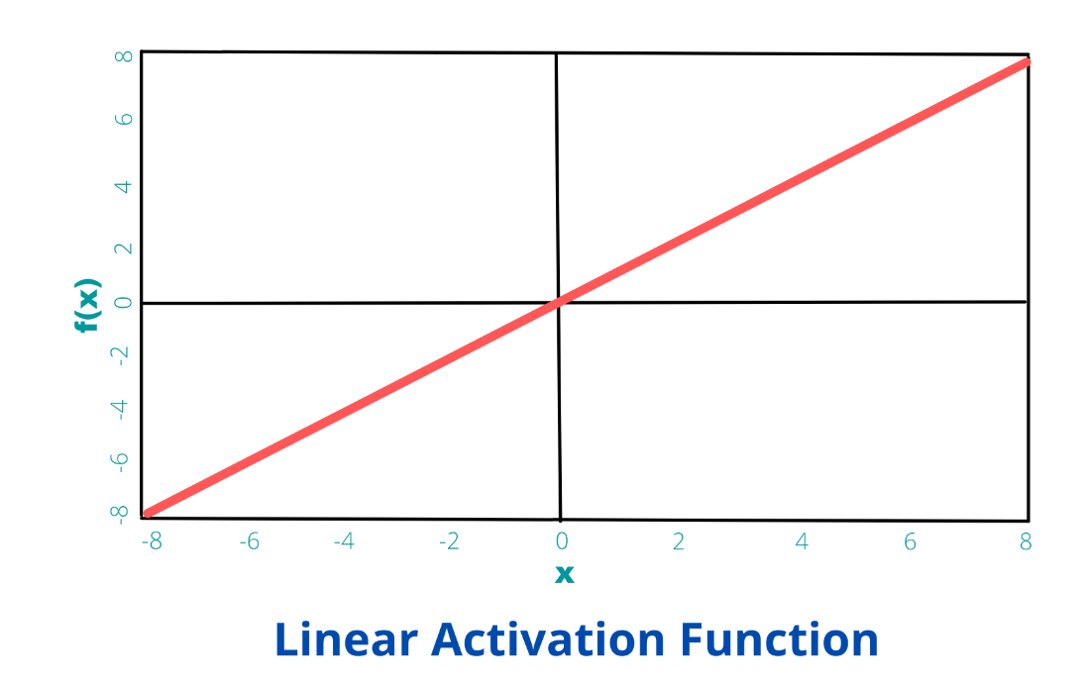
Linear Activation Function
The linear activation function, also known as "no activation," or "identity function" (multiplied x1.0), is where the activation is proportional to the input.
The function doesn't do anything to the weighted sum of the input, it simply spits out the value it was given.
It has the equation:
f(x) = kx, where k is a constant.

Slide 30
Disadvantage of Linear Activation Function
It’s not possible to use backpropagation as the derivative of the function is a constant and has no relation to the input x.
All layers of the neural network will collapse into one if a linear activation function is used. No matter the number of layers in the neural network, the last layer will still be a linear function of the first layer. So, essentially, a linear activation function turns the neural network into just one layer.

Slide 31
Non-Linear Activation Function
Most modern neural network uses the non-linear function as their activation function to fire the neuron.
They allow the model to create complex mappings between the network’s inputs and outputs, which are essential for learning and modelling complex data
They are helpful in datasets which are non-linear or have high dimensionality such as images, video, audio, etc.

Slide 32
Advantage of Non-linear function over the Linear function
Differential is possible in all the non-linear functions.
Stacking of networks is possible, which helps us in creating deep neural nets.
It makes it easy for the model to generalize or adapt with a variety of data and to differentiate between the output.
They allow backpropagation because now the derivative function would be related to the input, and it’s possible to go back and understand which weights in the input neurons can provide a better prediction.
They allow the stacking of multiple layers of neurons as the output would now be a non-linear combination of input passed through multiple layers. Any output can be represented as a functional computation in a neural network.

Slide 33
Important terminologies for Non-linear Activation function
Derivative or Differential: Change in y-axis w.r.t. change in the x-axis. It is also known as a slope.
Monotonic function: A function that is either entirely non-increasing or non-decreasing.

Slide 34
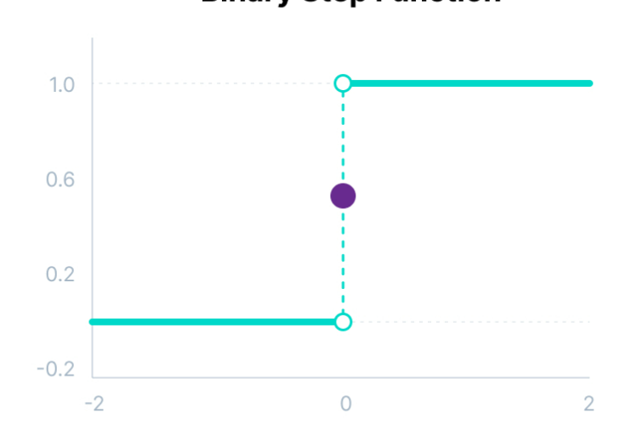
Binary Step Function or Heaveside Function or Unit Step Function
Binary step function depends on a threshold value that decides whether a neuron should be activated or not.
The input fed to the activation function is compared to a certain threshold.
If the input is greater than it, then the neuron is activated, else it is deactivated,
Its output is not passed on to the next hidden layer.

Slide 35
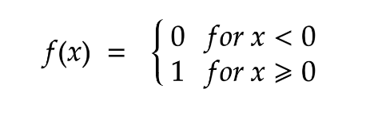
Binary Step Function
Mathematically it can be represented using the following equation:
Limitations:
It cannot provide multi-value outputs—for example, it cannot be used for multi-class classification problems.
The gradient of the step function is zero, which causes a hindrance in the backpropagation process.

Slide 36
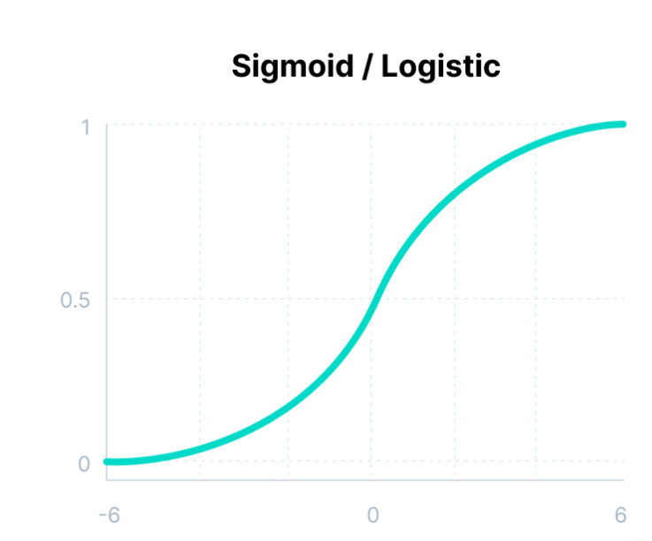
Sigmoid/ Logistic Activation Function
This function takes any real value as input and outputs values in the range of 0 to 1.
The larger the input (more positive), the closer the output value will be to 1.0, whereas the smaller the input (more negative), the closer the output will be to 0.0, as shown below.

Slide 37
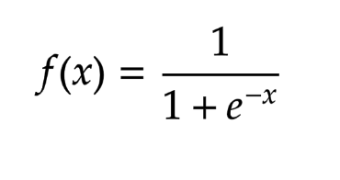
Sigmoid/ Logistic Activation Function
Mathematically it can be represented as follows:
Advantages of Sigmoid Activation Function:
It is commonly used for models where we have to predict the probability as an output. Since probability of anything exists only between the range of 0 and 1, sigmoid is the right choice because of its range.
The function is differentiable and provides a smooth gradient, i.e., preventing jumps in output values. This is represented by an S-shape of the sigmoid activation function.

Slide 38
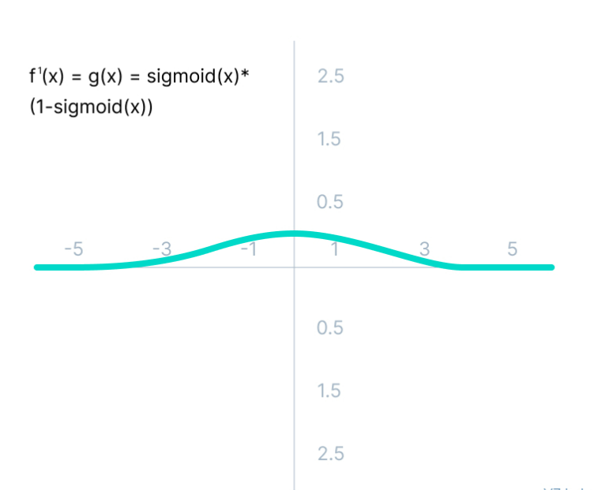
Sigmoid/ Logistic Activation Function
Limitations of Sigmoid Activation Function:
The derivative of the function is f'(x) = sigmoid(x)*(1-sigmoid(x)).

Slide 39
Sigmoid/ Logistic Activation Function
The gradient values are only significant for the range -3 to 3, and the graph gets much flatter in other regions.
It implies that for values greater than 3 or less than -3, the function will have very small gradients.
As the gradient value approaches zero, the network ceases to learn and suffers from the Vanishing gradient problem.
The output of the logistic function is not symmetric around zero.
So the output of all the neurons will be of the same sign.
This makes the training of the neural network more difficult and unstable.

Slide 40
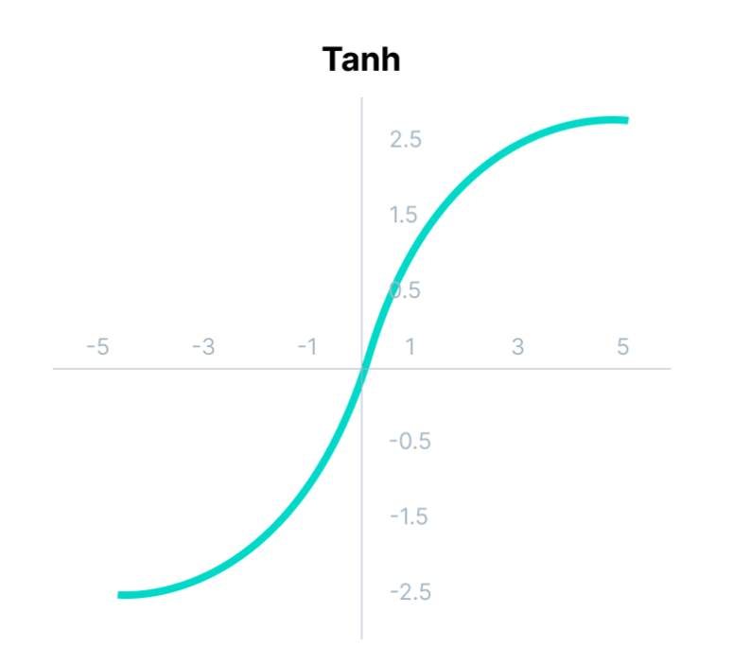
Tanh Function (Hyperbolic Tangent)
Tanh function is very similar to the sigmoid/logistic activation function and even has the same S-shape with the difference in the output range of -1 to 1.
In Tanh, the larger the input (more positive), the closer the output value will be to 1.0, whereas the smaller the input (more negative), the closer the output will be to -1.0.

Slide 41
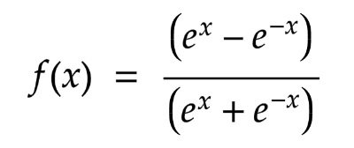
Tanh Function (Hyperbolic Tangent)
Mathematically it can be represented as follows:
Advantages :
The output of the tanh activation function is Zero centered; hence we can easily map the output values as strongly negative, neutral, or strongly positive.
Usually used in hidden layers of a neural network as its values lie between -1 to; therefore, the mean for the hidden layer comes out to be 0 or very close to it. It helps in centering the data and makes learning for the next layer much easier.

Slide 42
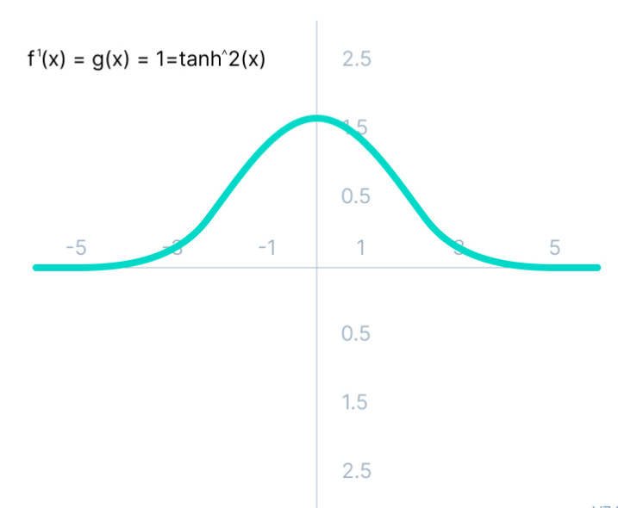
Limitations of tanh Functions
Tanh also faces the problem of vanishing gradients similar to the sigmoid activation function.
The gradient of the tanh function is much steeper as compared to the sigmoid function.
Fig: Gradient of the tanh activation function

Slide 43
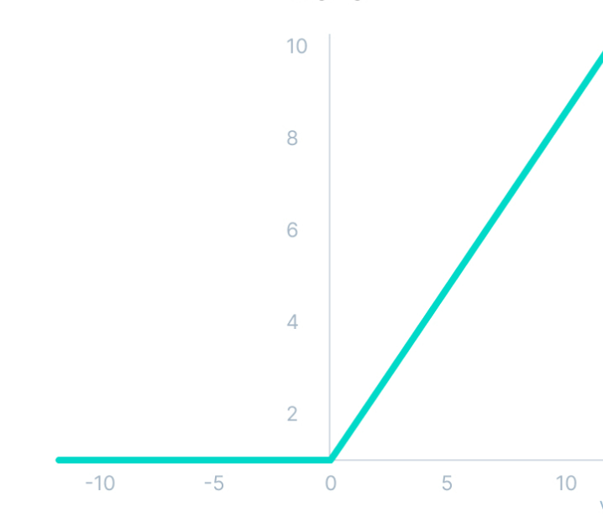
ReLU Functions
ReLU stands for Rectified Linear Unit.
Although it gives an impression of a linear function, ReLU is a derivative function.
It allows backpropagation and makes the process computationally efficient.
ReLU activation function

Slide 44
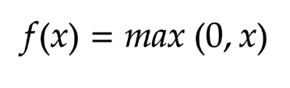
ReLU Functions
ReLU function does not activate all the neurons at the same time.
The neurons are only be deactivated if the output of the linear transformation is less than 0.
Mathematically it can be represented as follows:

Slide 45
ReLU Functions
The advantages of using ReLU as an activation function are as follows:
As a certain number of neurons are activated, it is far more computationally efficient when compared to the sigmoid and tanh functions.
ReLU accelerates the convergence of gradient descent towards the global minimum of the loss function due to its linear, non-saturating property.

Slide 46
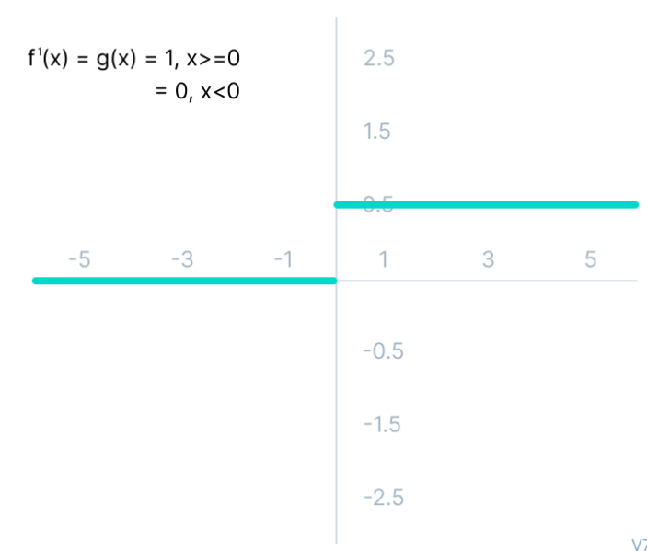
ReLU Functions
The limitations faced by this function are:
The Dying ReLU problem: The negative side of the graph makes the gradient value zero. Due to this reason, during the backpropagation process, the weights and biases for some neurons are not updated. This can create dead neurons which never get activated.
All the negative input values become zero immediately, which decreases the model’s ability to fit or train from the data properly.

Slide 47
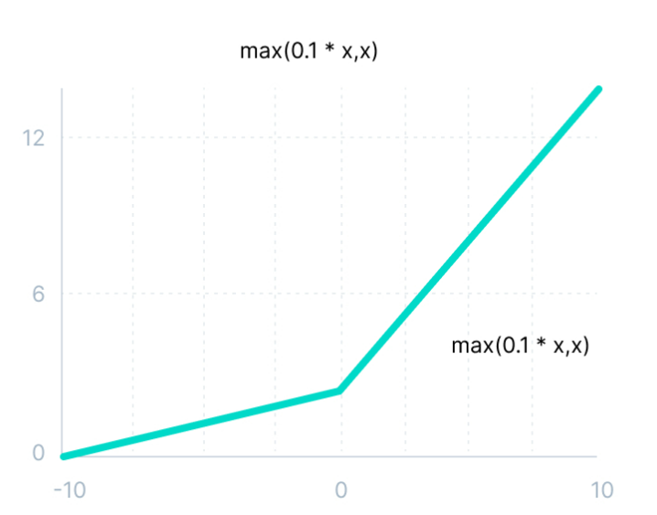
Leaky ReLU Functions
Leaky ReLU is an improved version of ReLU function to solve the Dying ReLU problem as it has a small positive slope in the negative area.

Slide 48
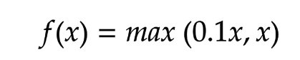
Leaky ReLU Functions
Mathematically it can be represented as follows:
The advantages of Leaky ReLU are same as that of ReLU.
Additionally it enables backpropagation, even for negative input values. By making this minor modification for negative input values, the gradient of the left side of the graph comes out to be a non-zero value. Therefore, dead neuron problems is resolved for negative inputs.

Slide 49
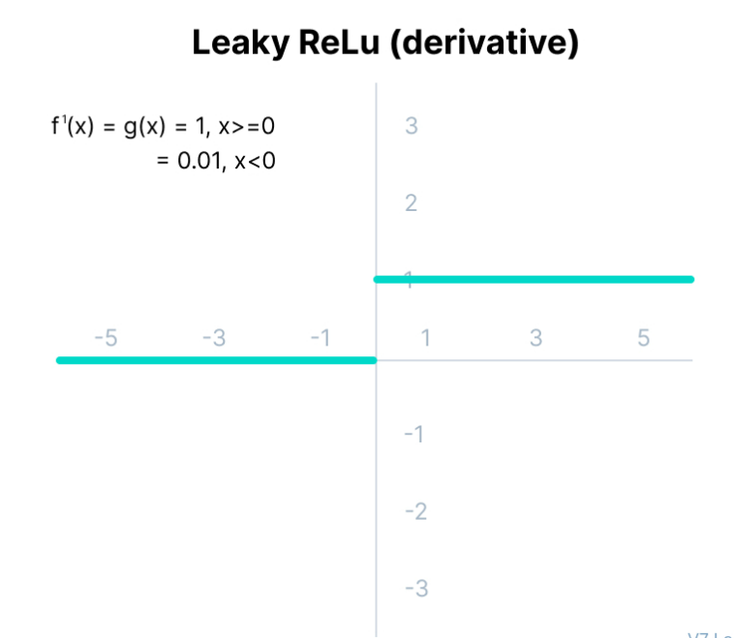
Leaky ReLU Functions
The limitations that this function faces include:
The predictions may not be consistent for negative input values.
The gradient for negative values is a small value that makes the learning of model parameters time-consuming.

Slide 50
Interconnections in Neural Network
Interconnection is the way neurons are connected to each other.
The arrangements of these processing elements and geometry of interconnections are very essential in ANN.
They have two common layers in all network architectures, viz., the Input layer and output layer.
The input layer buffers the input signal.
The output layer generates the output of the network.
The third layer is the Hidden layer, in which neurons are neither kept in the input layer nor in the output layer.
These neurons are hidden from the people who are interfacing with the system and act as a black box to them.
By increasing the hidden layers with neurons, the system’s computational and processing power can be increased but the training phenomena of the system get more complex at the same time.

Slide 51
Neural Network Architecture
There are five basic types of neuron connection/architectures :
Single-layer feed-forward network
Multilayer feed-forward network
Single node with its own feedback
Single-layer recurrent network
Multilayer recurrent network

Slide 52
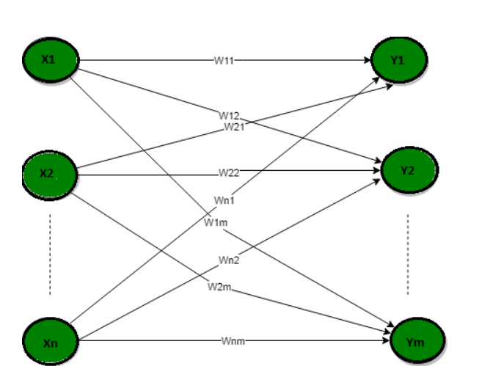
Single-layer feed-forward network
In this type of network, only two layers input layer and the output layer are present.
The input layer does not count because no computation is performed in this layer.
The output layer is formed when different weights are applied to input nodes and the cumulative effect per node is taken.

Slide 53
Single-layer feed-forward network
The neurons collectively give the output layer to compute the output signals.
In other words, this network is strictly of a feedforward type.
It is called a single-layer network, with the designation “single-layer” referring to the output layer of computation nodes (neurons)

Slide 54
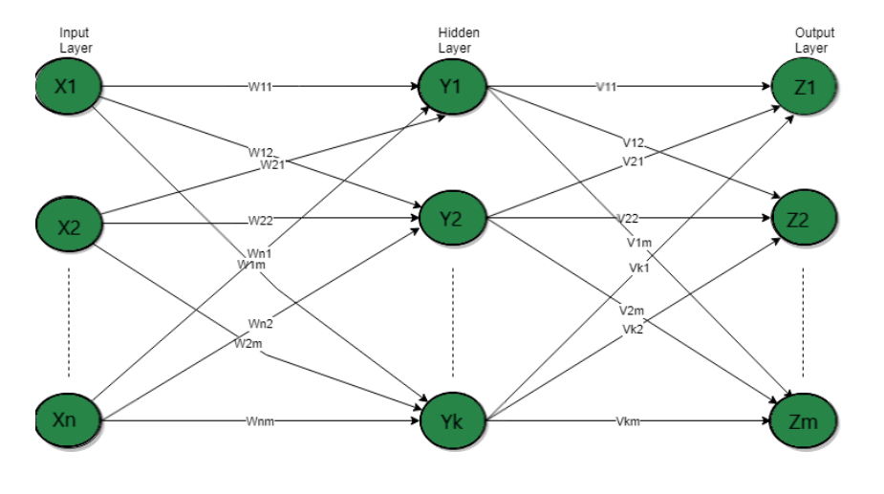
Multilayer feed-forward network
This feedforward neural network has one or more hidden layers.
These computation nodes are correspondingly called hidden neurons or hidden units.
The term “hidden” refers to the fact that this part of the neural network is not seen directly from either the input or output of the network.
The function of hidden neurons is to intervene between the external input and the network output.

Slide 55
Multilayer feed-forward network
By adding one or more hidden layers, the network is enabled to extract higher-order statistics from its input.
The network acquires a global perspective despite its local connectivity, due to the extra set of synaptic connections and the extra dimension of neural interactions.
The source nodes in the input layer of the network supply respective elements of the activation pattern (input vector), which constitute the input signals applied to the neurons (computation nodes) in the second layer (i.e., the first hidden layer).
The output signals of the second layer are used as inputs to the third layer, and so on for the rest of the network.
Typically, the neurons in each layer of the network have as their inputs the output signals of the preceding layer only.
The set of output signals of the neurons in the output (final) layer of the network constitutes the overall response of the network to the activation pattern supplied by the source nodes in the input (first) layer.

Slide 56
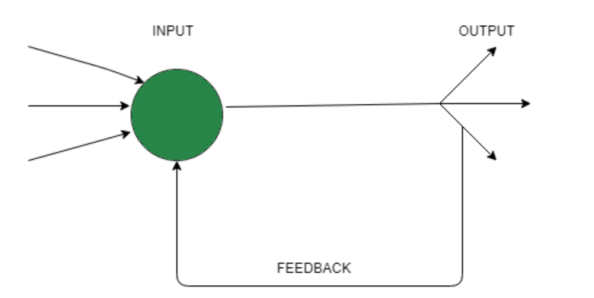
Single node with its own feedback
The networks where the output layer output is sent back as an input to the input layer or the other hidden layers is called Feedback Networks.
In single-node feedback systems, there is a single input layer where the output is redirected back as feedback.

Slide 57
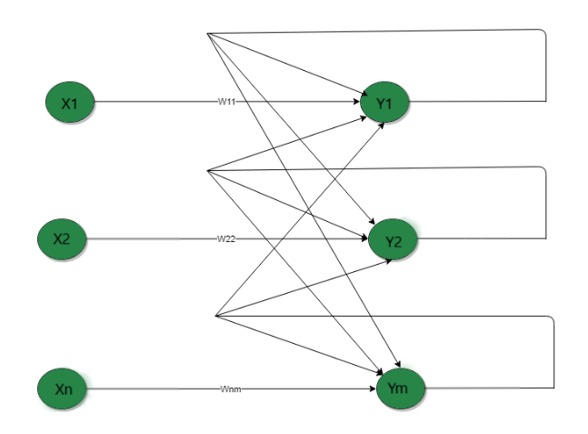
Single-layer recurrent network
In a single-layer recurrent network, the feedback network forms a closed loop.
A single neuron receives feedback to itself or the other neurons in the network or both.
The feedback network forms a closed loop.

Slide 58
Single-layer recurrent network
Here, the processing element’s output can be directed back to itself or to another processing element or both.
A recurrent neural network is a class of artificial neural networks where connections between nodes form a directed graph along a sequence.
This allows it to exhibit dynamic temporal behavior for a time sequence.
Unlike feedforward neural networks, RNNs can use their internal state (memory) to process sequences of inputs.

Slide 59
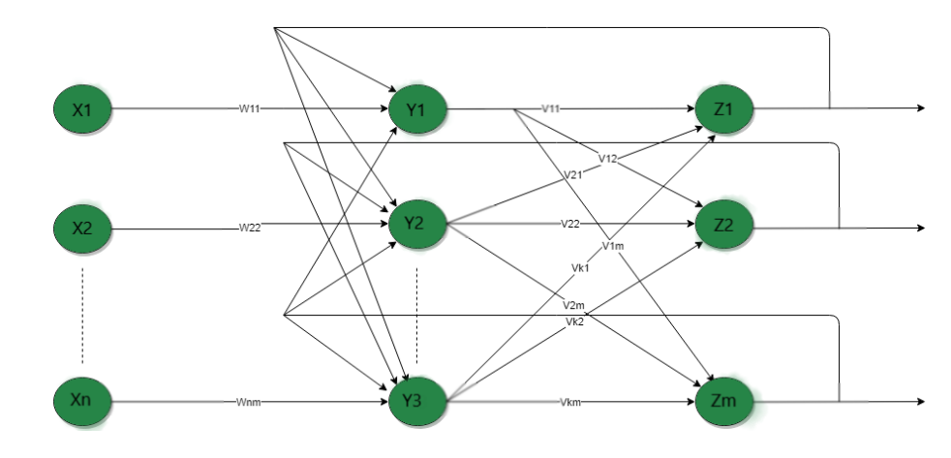
Multilayer recurrent network
The processing element’s output can be directed to the processing element in the same layer and in the preceding layer forming a multilayer recurrent network.
They perform the same task for every element of a sequence, with the output being dependent on the previous computations.
Inputs are not needed at each time step.
The main feature of a Recurrent Neural Network is its hidden state, which captures some information about a sequence.

Slide 60
Knowledge
Knowledge refers to stored information or models used by a person or machine to interpret, predict, and appropriately respond to the outside world.
The primary characteristics of knowledge representation are :
what information is actually made explicit
how the information is physically encoded for subsequent use.
Knowledge representation is goal directed.
In real-world applications of “intelligent” machines, it can be said that a good solution depends on a good representation of knowledge.
We find that the possible forms of representation from the inputs to internal network parameters are highly diverse, which tends to make the development of a satisfactory solution by means of a neural network a real design challenge.

Slide 61
Knowledge
Knowledge of the world consists of two kinds of information:
The known world state, represented by facts about what is and what has been known, this form of knowledge is referred to as prior information.
Observations (measurements) of the world, obtained by means of sensors designed to probe the environment, in which the neural network is supposed to operate.

Slide 62
Representing Information
Object: All the facts about objects in our world domain. E.g., Guitars contains strings, trumpets are brass instruments.
Events: Events are the actions which occur in our world.
Performance: It describe behavior which involves knowledge about how to do things.
Meta-knowledge: It is knowledge about what we know.
Facts: Facts are the truths about the real world and what we represent.
Knowledge-Base: The central component of the knowledge-based agents is the knowledge base. It is represented as KB. The Knowledge base is a group of the Sentences (Here, sentences are used as a technical term and not identical with the English language).

Slide 63

Types of Knowledge

Slide 64
Types of Knowledge
1. Declarative Knowledge:
Declarative knowledge is to know about something.
It includes concepts, facts, and objects.
It is also called descriptive knowledge and expressed in declarative sentences.
It is simpler than procedural language.
2. Procedural Knowledge
It is also known as imperative knowledge.
Procedural knowledge is a type of knowledge which is responsible for knowing how to do something.
It can be directly applied to any task.
It includes rules, strategies, procedures, agendas, etc.
Procedural knowledge depends on the task on which it can be applied.

Slide 65
Types of Knowledge
3. Meta-knowledge:
Knowledge about the other types of knowledge is called Meta-knowledge.
4. Heuristic knowledge:
Heuristic knowledge is representing knowledge of some experts in a filed or subject.
Heuristic knowledge is rules of thumb based on previous experiences, awareness of approaches, and which are good to work but not guaranteed.
5. Structural knowledge:
Structural knowledge is basic knowledge to problem-solving.
It describes relationships between various concepts such as kind of, part of, and grouping of something.
It describes the relationship that exists between concepts or objects.

Slide 66
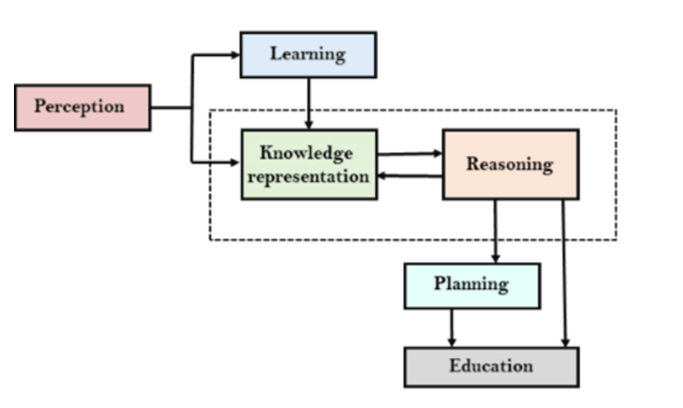
AI Knowledge Cycle

Slide 67
Rules of Knowledge Representation
Rule 1: Similar inputs (i.e., patterns drawn) from similar classes should usually produce similar representations inside the network, and should therefore be classified as belonging to the same class.
Rule 2: Items to be categorized as separate classes should be given widely different representations in the network.
Rule 3: If a particular feature is important, then there should be a large number of neurons involved in the representation of that item in the network.
Rule 4: Prior information and invariances should be built into the design of a neural network whenever they are available, so as to simplify the network design by its not having to learn them.

Slide 68
Learning in Neural Networks
Neural networks learn from its environment and improve its performance.
A neural network learns its environment through an interactive process of adjustments applied to its synaptic weights and bias.
We define learning in the context of neural networks as: Learning is a process by which the free parameters of a neural network are adapted through a process of stimulation by the environment in which the network is embedded.
The type of learning is determined by how the parameter changes take place.

Slide 69
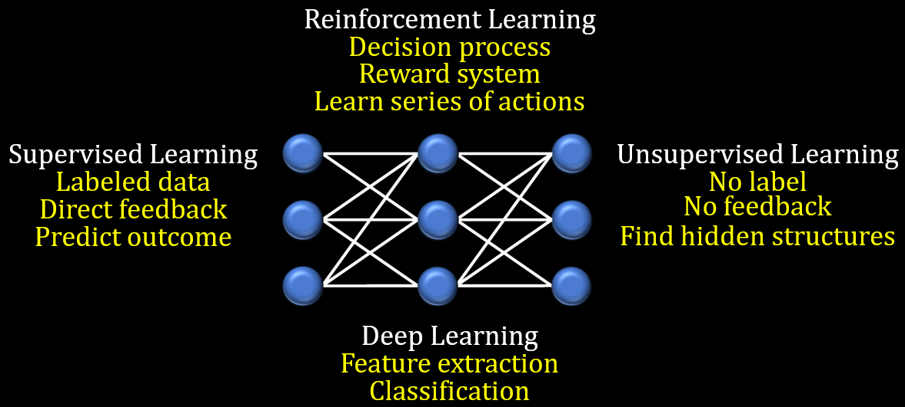
Types of Learning

Slide 70
Learning Algorithm
Since the single layer perceptron is a supervised neural network architecture, it requires learning of some a priori knowledge base for its operation.
This learning paradigm for a single layer perceptron can be summarized as follows:
• Set the weights and thresholds randomly.
• Calculate the actual outputs by taking the thresholded value of the weighted sum of the inputs.
• Alter the weights to reinforce correct decisions and discourage incorrect decisions, i.e. reduce the error.

Slide 71
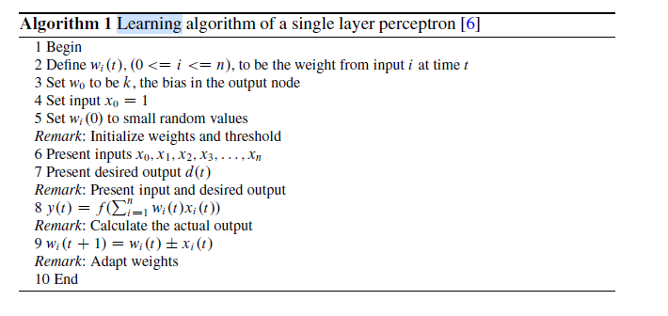
Learning Algorithm

Slide 72
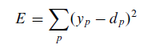
Learning Algorithm
The weights are unchanged if the net makes the correct decision.
The weights are also not adjusted on input lines which do not contribute to the incorrect response, since each weight is adjusted by the value of the input on that line, xi , which would be zero.
In order to predict the expected outputs, a loss (also called objective or error) function E can be defined over the model parameters to ascertain the error in the prediction process.
A popular choice for E is the sum-squared error, given by
It is the sum over all points i in the data set of the squared difference between the target value di and the perceptron’s prediction yi , calculated from the input value xi .
For a linear model, the sum-squared error is a quadratic function of the model parameters.

Slide 73
Learning Algorithm
The loss function E provides an objective measure of predictive error for a specific choice of perceptron model parameters.
Minimizing the loss function would yield more accurate predicted outputs by the perceptron.

Slide 74
Supervised Learning
A neural network is trained with the help of a set of patterns known as the training vectors. The outputs for these vectors might be, or might not be, known beforehand.
When these are known, and that knowledge is employed in the training process, the training is termed as supervised learning.
Some popular supervised learning methods are perceptron learning, delta learning, least-mean-square (LMS) learning, correlation learning, outstar learning etc.

Slide 75
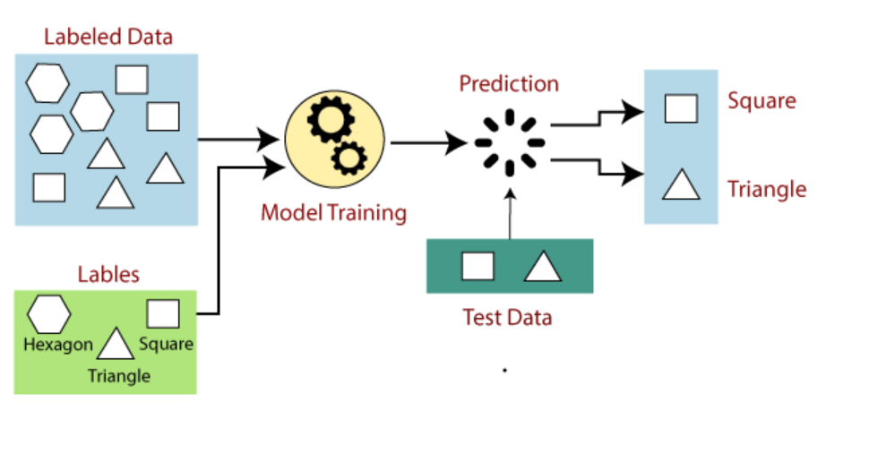
Supervised Learning

Slide 76
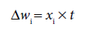
Hebb Rule
Hebb rule is one of the earliest learning rules for ANNs.
According to this rule the weight adjustment is computed as
where t is the target activation.
Important facts regarding Hebb learning rule:
Hebb rule cannot learn when the target is 0, because the weight adjustment becomes zero when t = 0, irrespective of the input value.
the Hebb rule results in better learning if the input / output both are in bipolar form.
Hebb rule does not guarantee to learn a classification instance even if the classes are linearly separable.

Slide 77
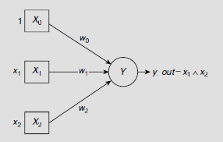
Hebb Rule- Realizing the logical AND function through Hebb learning
To realize a two-input AND function we need a net with two input units and one output unit. A bias is also needed. Hence the structure of the required neural net should be as shown in Fig. 2. Moreover, the input and output signals must be in bipolar form, rather than the binary form, so that the net may be trained properly. Considering the truth table of AND operation, and the fact that the bias is permanently set to 1, we get the training set depicted in Table 1.
Fig 1.

Slide 78
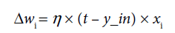
Delta/ LMS (Least Mean Square) Rule
Least Mean Square (LMS), also referred to as the Delta, or Widrow-Hoff Rule, is another widely used learning rule in ANN.
Here the weight adjustment is computed as:
In LMS learning, the identity function is used as the activation function during the training phase.
The learning rule minimizes mean squared error between the activation and the target value.
The output of LMS learning is in binary form.

Slide 79
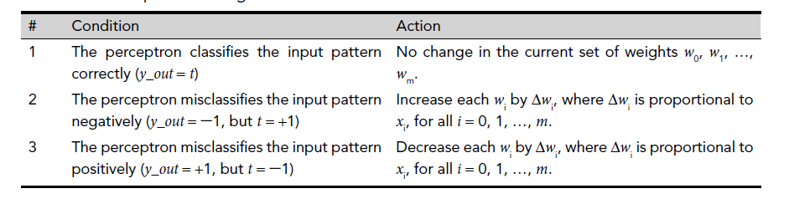
Perceptron Learning Rule
The perceptron learning rule is informally stated as :
IF the output is erroneous THEN adjust the interconnection weights ELSE leave the interconnection weights unchanged.

Slide 80
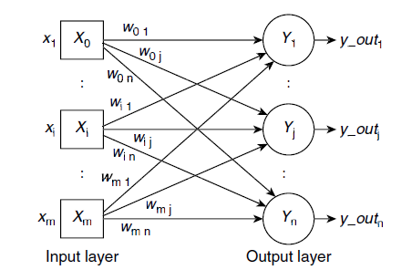
Perceptron Learning Rule
The perceptron learning rule is formulated as :

Slide 81
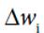
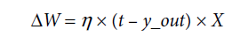
Perceptron Learning Rule
The perceptron learning rule can be formulated as:
Here h is a constant known as the learning rate.
When a training vector is correctly classified then y_out = t, and the weight adjustment = 0. When y_out = -1 but t = +1, i.e., the pattern is misclassified negatively, then t - y_out = +2 so that is incremental and is proportional to
xi.
If, however, the input pattern is misclassified positively, the adjustment is decremental.
Using matrix notation, the perceptron learning rule may now be written as
where, and X are the vectors corresponding to the interconnection weights and the inputs.

Slide 82
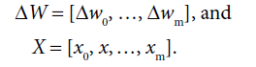
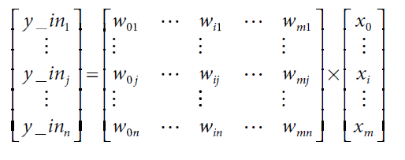
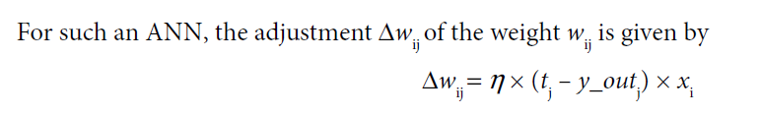
Perceptron Learning Rule
The net inputs to the perceptrons are

Slide 83
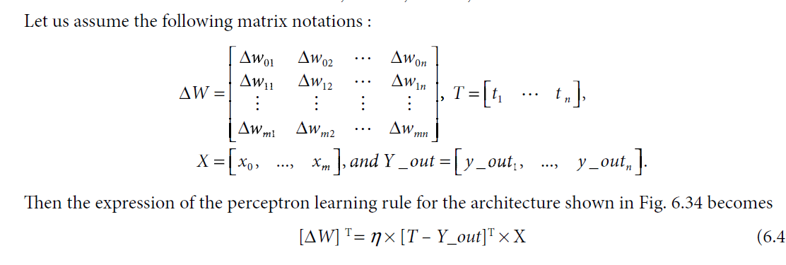
Perceptron Learning Rule

Slide 84
References
https://medium.com/analytics-Vidhya/brief-history-of-neural-networks-44c2bf72eec
Haykin, Simon. “Neural networks and learning machines”, 3/E. Pearson Education India, 2011.
Bhattacharyya, Siddhartha & Maulik, Ujjwal, “Soft Computing for Image and Multimedia Data Processing”, Springer Berlin, Heidelberg, 2013.

Slide 85
Thank You!

